Slide 1

Confusion Matrix Metrics Part 1 (Accuracy, Precision, Recall)
Machine learning

Slide 2
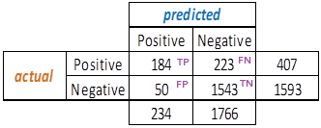
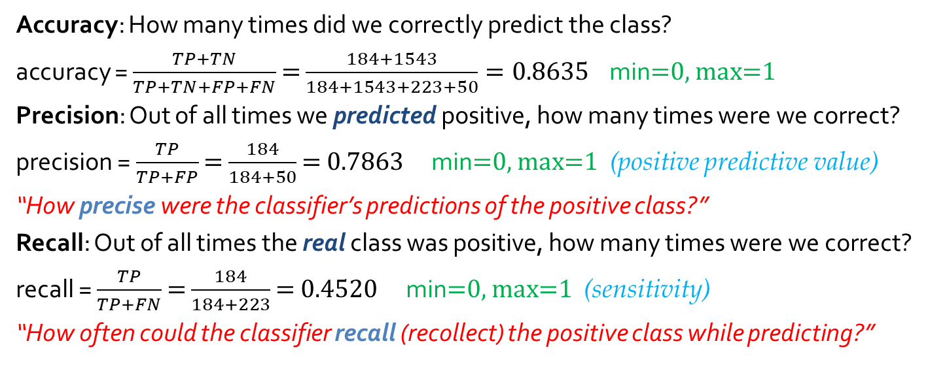
Churn modeling dataset.
Positive: customer exited bank
Accuracy: How many times did we correctly predict the class?
accuracy = $\frac{TP+TN}{TP+TN+FP+FN}$ = $\frac{184+1543}{184+1543+223+50}=0.8635$ min=0, max=1
Precision: Out of all times we predicted positive, how many times were we correct?
precision = $\frac{TP}{TP+FP}$ = $\frac{184}{184+50}$ = 0.7863 min=0, max=1 (positive predictive value)
“How precise were the classifier’s predictions of the positive class?”
Recall: Out of all times the real class was positive, how many times were we correct?
recall = $\frac{TP}{TP+FN}$ = $\frac{184}{184+223}$ = 0.4520 min=0, max=1 (sensitivity)
“How often could the classifier recall (recollect) the positive class while predicting?”

Slide 3
Confusion Matrix Metrics Part 2 (Precision-Recall trade-off)
Machine learning

Slide 4
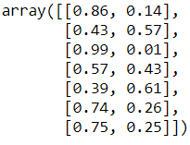









Precision-Recall trade-off
Churn modeling dataset.
Positive: customer exited bank
In a classification model, mostly we’re calculating the “probability” of a data point to belong to a particular class
For eg, for a binary task:
We will discard the negative (0) class, and work only with the positive class.
The default threshold is 0.5 or 50%, but we can alter it to suit our business needs.
P=0.44, R=0.75
P=0.55, R=0.65
0 1
1
th = 0.5
y_true
P=0.67, R=0.53
Both class probs
+ve class prob
P=0.79, R=0.45
P=0.92, R=0.27
P=0.97, R=0.16
precision = $\frac{TP}{TP+FP}$ recall = $\frac{TP}{TP+FN}$
P , R
P=1, R=0.05
P , R

Slide 5
Confusion Matrix Metrics Part 3 (F1 score and its shortcomings)
Machine Learning

Slide 6

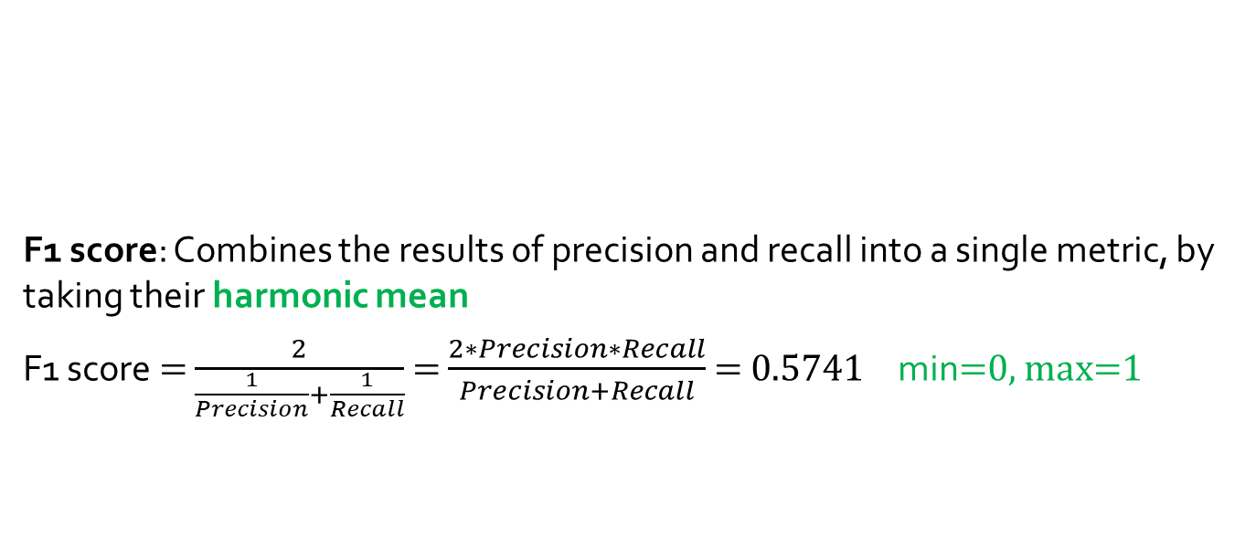


F1 score: Combines the results of precision and recall into a single metric, by taking their harmonic mean
F1 score = $\frac{2}{\frac{1}{Precision}+\frac{1}{Recall}}$ = $\frac{2∗Precision∗Recall}{Precision+Recall}$ = 0.5741 min=0, max=1
Churn modeling dataset.
Positive: customer exited bank
precision = $\frac{TP}{TP+FP}$
recall = $\frac{TP}{TP+FN}$

Slide 7
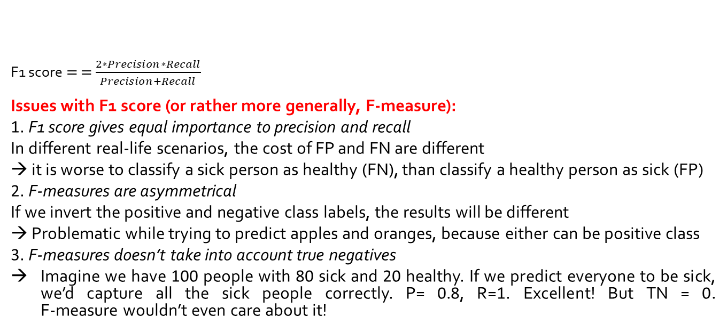


Churn modeling dataset.
Positive: customer exited bank
F1 score = = $\frac{2∗Precision∗Recall}{Precision+Recall}$
Issues with F1 score (or rather more generally, F-measure):
1. F1 score gives equal importance to precision and recall
In different real-life scenarios, the cost of FP and FN are different
→ it is worse to classify a sick person as healthy (FN), than classify a healthy person as sick (FP)
2. F-measures are asymmetrical
If we invert the positive and negative class labels, the results will be different
→ Problematic while trying to predict apples and oranges, because either can be positive class
3. F-measures doesn’t take into account true negatives
Imagine we have 100 people with 80 sick and 20 healthy. If we predict everyone to be sick, we’d capture all the sick people correctly. P= 0.8, R=1. Excellent! But TN = 0. F-measure wouldn’t even care about it!
precision = $\frac{TP}{TP+FP}$
recall = $\frac{TP}{TP+FN}$

Slide 8
Confusion Matrix Metrics Part 4 (F-beta score)
Machine Learning

Slide 9
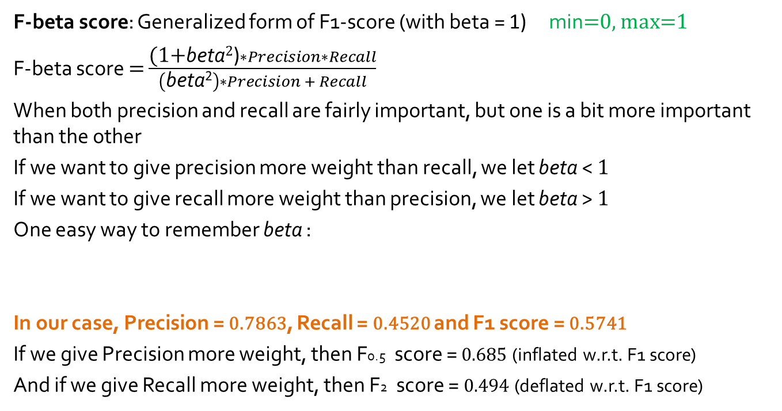
F-beta score: Generalized form of F1-score (with beta = 1) min=0, max=1
F-beta score = $\frac{\text{(}\text{1+}\text{beta}\text{2}\text{)}∗Precision∗Recall}{\left(\text{beta}\text{2}\right)∗Precision + Recall}$
When both precision and recall are fairly important, but one is a bit more important than the other
If we want to give precision more weight than recall, we let beta < $\text{1}$
If we want to give recall more weight than precision, we let beta > $\text{1}$
One easy way to remember beta :
In our case, Precision = 0.7863, Recall = 0.4520 and F1 score = 0.5741
If we give Precision more weight, then F0.5 score = 0.685 (inflated w.r.t. F1 score)
And if we give Recall more weight, then F2 score = 0.494 (deflated w.r.t. F1 score)
(P)recision – more weight | Q (between P & R) – equal weight | (R)ecall – more weight
beta = 0.5 ( < 1) | beta = 1 | beta = 2 ( > 1)

Slide 10


What to prioritize: Precision or Recall? Depends.
precision = $\frac{TP}{TP+FP}$
recall = $\frac{TP}{TP+FN}$
If we have a case where minimizing false positives is more important than minimizing false negatives, we prioritize precision over recall
For eg, it is super important to not let a good email (0) be classified as spam (1), hence we need to reduce falsely spam or false positive. (beta < 1)
If we have a case where minimizing false negatives is more important than minimizing false positives, we prioritize recall over precision.
For eg, it is super important to not let a dangerous (1) weapon pass a security check and be classified as safe(0), hence we need to reduce falsely safe or false negative. (beta > 1)

